Slide 1

TEAM3
FINAL STATUS REPORT
Pinxi Lyu, Ananya Jhamb, Shaibah Raiyan, Friedemann Schmidt，Dixin Guo, Yifu Huang

Slide 2
DATA PREPARATION
1. Data sources
CMS Medicare Advantage Landscape files (CY2025 and CY2026) were used to identify plan presence, parent organizations, plan characteristics, premiums, MOOP, and star ratings.
CMS monthly enrollment files (2025-01 to 2026-03) were used to construct county-level ACHP enrollment trends over time.
ACHP member crosswalk files (2025 and 2026) were used to identify which contracts belonged to ACHP member plans.
2. Cleaning and standardization
Standardized state, county, parent organization, and contract identifiers across files using uppercase conversion, trimming, and whitespace normalization.
Harmonized year-specific column names in the Landscape files to make 2025 and 2026 records comparable.
Normalized county names to reduce inconsistencies across datasets and improve county-level matching accuracy.
3. Missing value handling
Converted enrollment fields to numeric and treated blank values as 0 when building the monthly enrollment panel.
Treated non-numeric placeholders such as “Not Applicable” or “Not Available” in premium, MOOP, and star rating fields as missing values in downstream feature analysis.
Retained missingness where appropriate rather than forcing imputation for plan characteristics.
4. Feature engineering and aggregation
Constructed ContractPlanID by combining contract and plan identifiers.
Defined exit exposure at the county–parent organization level, identifying markets present in 2025 but absent in 2026.
Created analytical features including is_achp, is_exit_county, and num_exiting_carriers.
Aggregated matched data into county-level and monthly trend datasets, and computed key outcome metrics: achp_share, achp_delta, and share_delta.
Pinxi Lyu，Dixin Guo

Slide 3
LITERATURE REVIEW
Market Structure & Scale
Market Players & Plans
Market is highly concentrated
National insurances dominate, though all are exiting counties and trimming plan offerings
Sizabeal reduction in number of plans offered
Non-SNP plan count fell 10% YoY
Counties with only one insurer rose to 171 (from 139 in 2024)
Special Needs Plans (D-SNPs, C-SNPs) are the primary growth vector, with C-SNP offerings up 47%
Average of 8 plan options & 32 different presicription plans (down from 36 in 2024)
Enrollment
MA enrollment reached 35.4M beneficiaries in 2026, now covering 51% of all Medicare-eligible individuals
5-fold increase since 2004
Slowdown in growth over recent years
2.5% YoY in 2026 vs. 7–10% annual growth in the early 2020s
Penetration highly geography-dependent
Florida, California, Texas, Pennsylvania, and New York, account for approximately 37%
Few offerings in rural states (i.e. Alaska, Wyoming, Vermont)
Friedemann Schmidt

Slide 4
LITERATURE REVIEW
Financial & Economic Pressures
Regulatory Tailwinds & Outlook
MA plans collectively posted a $5.7B underwriting loss in 2024
nearly three-quarters of MA-concentrated companies reported losses
Elevated utilization (outpatient, orthopedic, specialty drug) driven by post-COVID pent-up demand and Baby Boomer aging-in
Benefit generosity is declining for the first time in a decade: supplemental benefit value dropped
~$7 PMPM for general enrollment plans, ~$30 PMPM for D-SNPs
CY 2026 rate update was generous at +5.06%, but CY 2027 proposed at only +0.09% — well below the decade average of 3.88%
Full transition to CMS-HCC V28 risk model completed in 2026 — projected to reduce average risk scores by 3.12%
~$11B in Medicare savings
CMS proposes excluding unlinked chart reviews from risk scoring in 2027, targeting
$7B in estimated overpayments
Star Ratings tightening: 4+ star contracts declined 25% between 2022–2025, directly reducing quality bonus payments and rebate percentages
Long-term demographic tailwind intact
Baby Boomers aging in through mid-2030s
Plans must shift from coding-driven margins to operational efficiency and clinical value delivery
Friedemann Schmidt

Slide 5
EXTERNAL DATA
Integration
The 2024 data is merged with the existing dataset using Contract ID and Plan ID to construct a 2024–2026 panel dataset. This structure enables us to track each plan over time and identify whether it entered, exited, or remained active across years.
2024 Enrollment Performance
Justification
The current dataset only covers 2025–2026, which limits our ability to distinguish between true carrier exits and normal year-to-year variation. Without a prior baseline, it is difficult to fully understand changes in market dynamics. Therefore, we incorporate 2024 data to establish a baseline and enable a more complete longitudinal analysis.
Why it matters
•Identify carrier exits
• Assess ACHP enrollment gains
• Distinguish market vs. plan effects
Source
CMS Monthly MA Enrollment Data (2024)
Same structure as 2025–2026 data
Dixin Guo
https://www.cms.gov/data-research/statistics-trends-and-reports/medicare-advantagepart-d-contract-and-enrollment-data/monthly-ma-enrollment-state/county/contract

Slide 6
EXTERNAL DATA
Integration
The dataset is merged at the county level using State + County or FIPS codes, enriching each plan with market-level attributes such as market size and market maturity (high vs. low penetration).
Medicare Advantage Penetration
Justification
Existing CMS datasets provide detailed plan-level information (e.g., enrollment, cost, and quality), but they lack key market-level context such as total Medicare population and MA penetration. Without this, it is difficult to determine whether enrollment growth is driven by plan competitiveness or broader market conditions.
Why it matters
Distinguish market-driven vs. plan-driven growth
Improve benchmarking accuracy
Enhance interpretation of competitive dynamics
Source
CMS MA State/County Penetration Data
Provides:
Medicare eligibles (market size)
MA enrollment (total)
Penetration rate
https://www.cms.gov/data-research/statistics-trends-and-reports/medicare-advantagepart-d-contract-and-enrollment-data/ma-state/county-penetration?utm
Dixin Guo

Slide 7
EXTERNAL DATA
Integration
The dataset is merged with the primary data at the county level using FIPS or State + County, allowing each plan to be assigned a market type (urban vs. rural) and enabling segmentation by market environment.
Rural–Urban Market Classification
Justification
•Plan-level data captures enrollment, cost, and quality, but lacks important market structure information such as urban–rural classification and differences in healthcare access and competition. Without this context, it is difficult to explain variations in performance across regions.
Why it matters
• Explains differences in access, competition, and growth patterns
• Identifies whether ACHP plans are concentrated in specific market types
• Improves interpretation of enrollment and performance variation
Source
• USDA Rural–Urban Continuum Codes (RUCC)
• Classifies counties into urban -rural categories
Dixin Guo
https://www.ers.usda.gov/data-products/rural-urban-continuum-codes?

Slide 8
UPDATE EXTERNAL DATA FOR POSSIBLE FUTURE ANAYLYSIS
CENSUS / ACS DEMOGRAPHICS
Integration
The ACS data is merged with the existing county-level panel using county FIPS codes. We use these variables as time-invariant or slow-moving controls to enrich the 2025–2026 analysis and better account for structural differences across counties.
Justification
The core CMS files capture plan participation and enrollment outcomes, but they do not describe the demographic and socioeconomic context of each county. To better explain differences in market response, we add county-level Census / ACS variables such as total population, population aged 65 and over, median household income, poverty rate, and educational attainment. These variables help us control for underlying demand conditions and community characteristics
Why it matters
• Controls for county demographic composition
• Captures socioeconomic differences across markets
• Helps explain variation in enrollment response and market resilience
Source
U.S. Census Bureau, American Community Survey (ACS) 5-Year Data
Latest nationwide county-level release: 2024 ACS 5-year estimates
Yifu Huang
https://www.census.gov/data/developers/data-sets.html

Slide 9
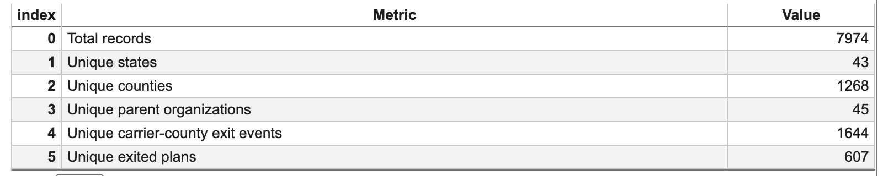
EDA
https://colab.research.google.com/drive/1eOOoszz1NnOLV8tOj4cvHdBFVuy0t6t5?usp=sharing
Key Variable Distributions and Summary Statistics
Findings
The plan exit dataset contains 7,974 records, representing 607 unique exited plans.
These exited plans span 43 states and 1,268 counties.
The dataset includes 45 parent organizations and 1,644 carrier-county exit events.
Yifu Huang

Slide 10
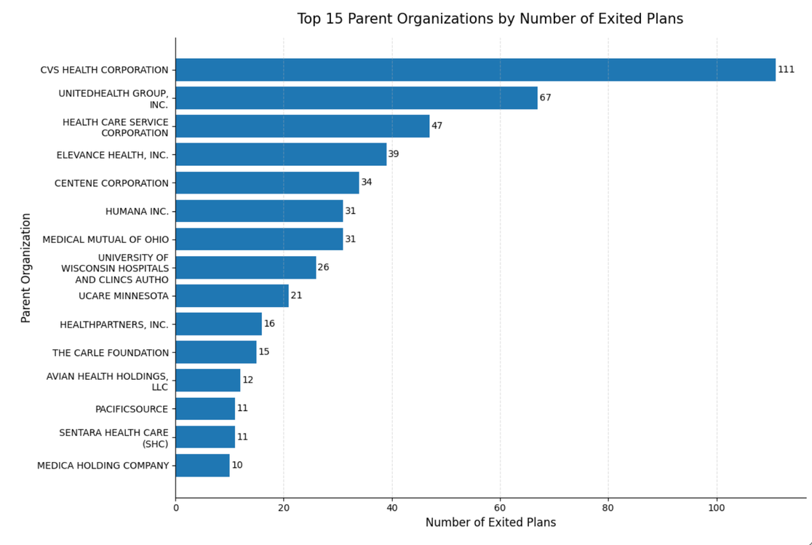
EDA
Initial Patterns in Exited Plans
Findings:
Exited plans are not evenly distributed across parent organizations.
A small number of large parent organizations account for a higher share of exited plans
CVS Health, UnitedHealth Group, and Health Care Service Corporation appear among the top organizations in the exit dataset.
This provides a basic carrier-level view for the later market analysis.
Yifu Huang

Slide 11
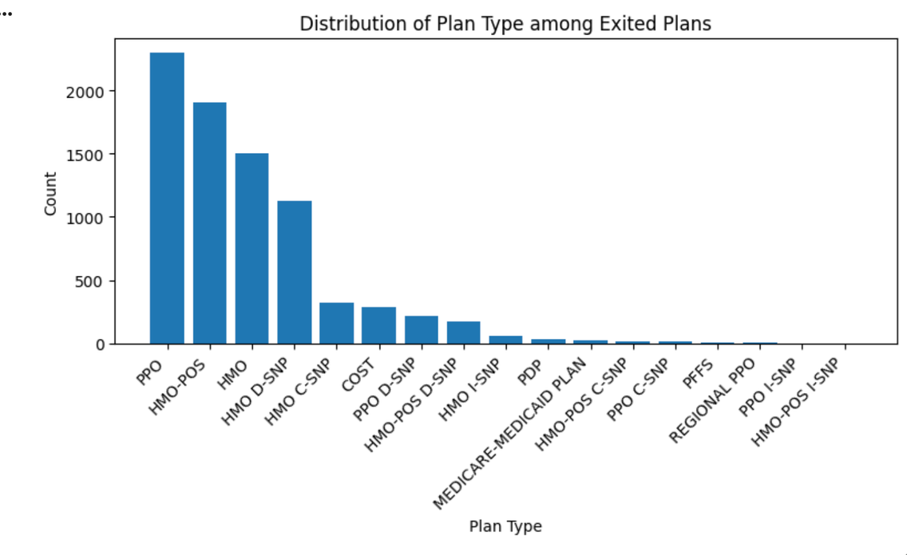
EDA
Initial Patterns in Plan Types
Findings:
Among exited plans, PPO is the most common plan type, followed by HMO-POS, HMO, and HMO D-SNP.
Exited plans are concentrated in a few major product categories rather than being evenly spread across all plan types.
Most of these counties involve multiple parent organizations, rather than a single exiting carrier.
Yifu Huang

Slide 12
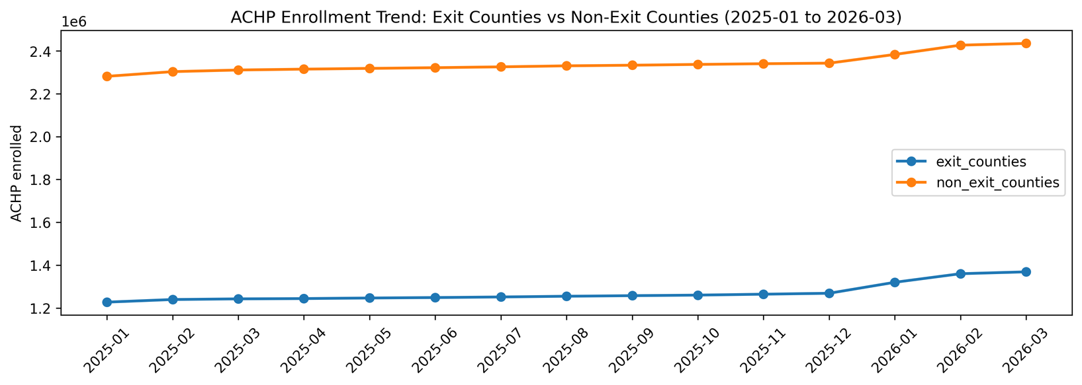
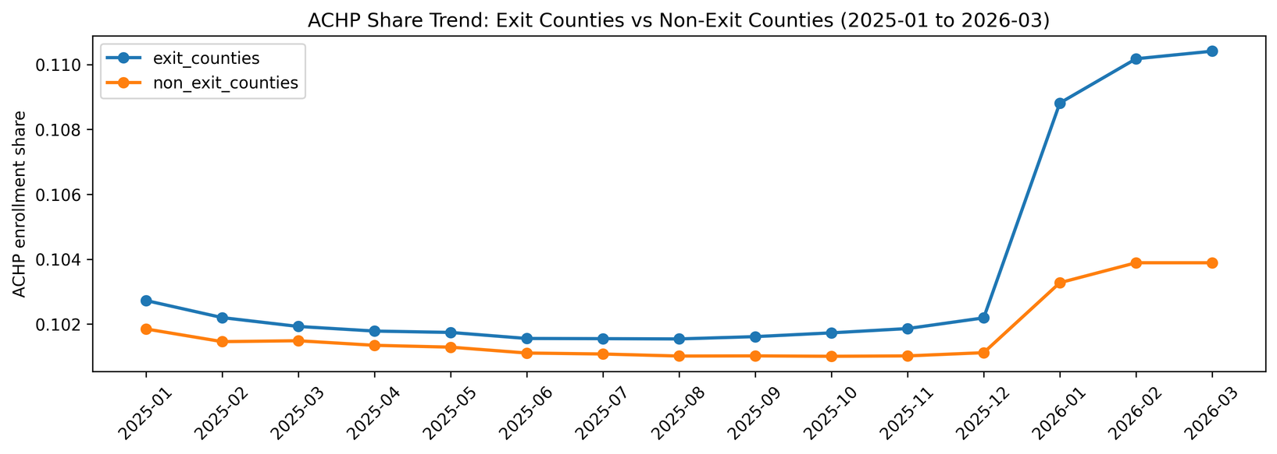
https://colab.research.google.com/drive/11Yg0rKcoB4LcRZDr5ftqAp1s_vBCTJ1W?usp=sharing、
EDA-UPDATE
ENROLLMENTACHP PICK UP
ACHP’s stronger share gains in exit counties indicate that market disruption translated into competitive pickup, not just background growth.
Findings：
Broad market growth lifted enrollment everywhere, but did not explain the full gap.
Exit counties showed a sharper step-up in ACHP share from late 2025 onward.
Implication: ACHP appears better positioned to convert carrier withdrawal into local share gains.
Pinxi Lyu，Dixin Guo

Slide 13
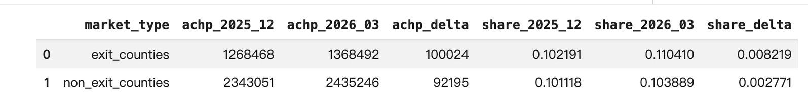
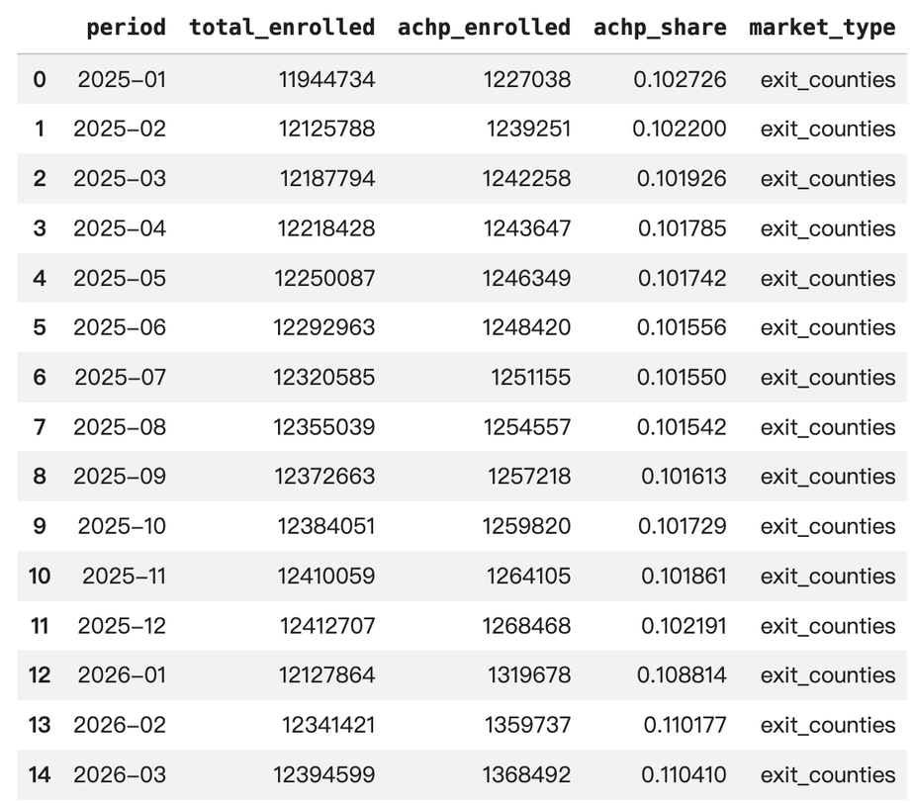
EDA-UPDATE
ENROLLMENTACHP PICK UP
The key signal is not just enrollment growth, but a step-change in relative market position after late 2025 in exit-affected counties.
Findings：
ACHP enrollment increased across both exit and non-exit counties, suggesting a broad growth backdrop rather than an exit-specific pattern in absolute membership alone.
The sharper distinction is in share: ACHP gained 0.82 percentage points in exit counties versus 0.28 points in non-exit counties, indicating materially stronger relative performance where carrier exits occurred.
The timing also matters: the widening gap becomes most visible from late 2025 into early 2026, consistent with ACHP capturing a larger share of post-exit market reallocation rather than merely participating in overall market growth.
Pinxi Lyu，Dixin Guo

Slide 14
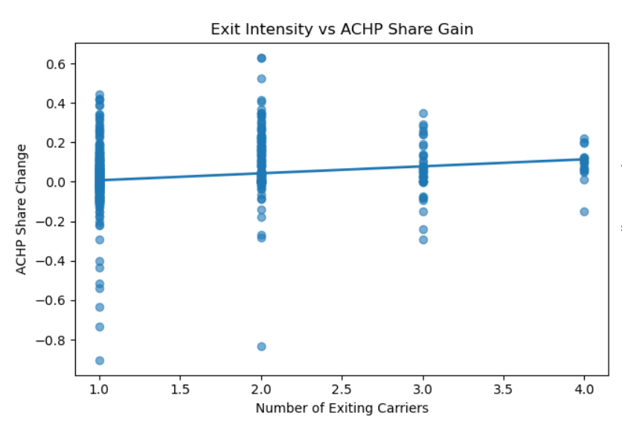
EDA-UPDATE
https://colab.research.google.com/drive/1VUx9hjGHfSwvhQhFC-fSlj26_bNwZisI?usp=sharing
MORE CARRIER EXITS DO NOT TRANSLATE TO HIGHER ACHP PICKUP
Findings：
Counties with 1 exiting carrier show ACHP share changes ranging from -0.9 to +0.45 — no consistent direction
The regression line is flat across 1 to 4 exiting carriers — exit count explains nothing
Same number of exits, completely different ACHP outcomes — the signal lies elsewhere
Dixin Guo

Slide 15
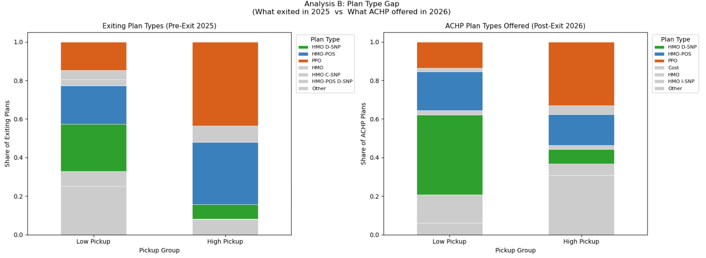
EDA-UPDATE
ACHP Gains Most Where Product Match Is Worst
In High Pickup counties, PPO (44%) and HMO-POS (32%) dominated exits — ACHP replaced only 33% and 16% respectively, leaving a 40-point combined gap
In Low Pickup counties, D-SNP was over-covered (24% exited vs 41% ACHP offered) — strongest product alignment, yet lowest pickup
The pattern is consistent: where ACHP matched best, it gained least — where the gap was largest, it gained most
Product fit does not drive pickup. PPO and HMO-POS exits created a market vacuum — ACHP gained because beneficiaries had no comparable alternative
Dixin Guo

Slide 16
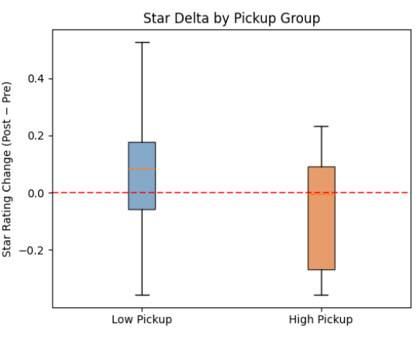
EDA-UPDATE
Where Strong Competitors Exit, Quality Falls and ACHP Gains Most
Findings：
Low Pickup counties: median star delta +0.08, IQR mostly above zero — weak plans exited, market quality improved and remained competitive
High Pickup counties: median star delta near zero, IQR extending sharply to -0.27 — strong competitors exited, market quality deteriorated significantly
The divergence is statistically significant (p < 0.0001) — quality decline in High Pickup counties is not random
When strong plans exit, beneficiaries lose their best options and ACHP becomes the most viable alternative — declining star ratings are not a warning, they are the earliest signal that a competitive vacuum is forming and ACHP's next opportunity is opening
Dixin Guo

Slide 17
SCQR FRAMEWORK
SITUATION
National MA carriers (CVS, UHC, HCSC) exited 607 plans across 43 states and 1,268 counties in 2025- 2026, displacing thousands of beneficiaries
COMPLICATION
ACHP share grew from 10.22% to 11.04% in exit counties vs. 10.11% to 10.39% in stables, but the driver isn't exit count or product fit. High-pickup counties saw star ratings fall to -0.27 post-exit suggesting quality decline, not plan match.
QUESTION
When big insurers leave a market, which markets does ACHP win and can falling star ratings and rising market concentration predict the next opportunity?
RESOLUTION
Using CMS enrollment, star ratings, and HHI shifts, we triage counties into Expand (185: concentration↑ & ACHP share↑) and Defend (73: concentration↑ & ACHP share↓) so ACHP acts before displaced beneficiaries make switching decisions.
Ananya Jhamb

Slide 18
FINDINGS
Market Share Shift: While ACHP enrollment increased broadly across both exit and non-exit counties, market share gains were significantly pronounced in areas with competitor flight. ACHP gained 0.82 percentage points in market share in exit counties, compared to only 0.28 percentage points in non-exit counties.
Timing of Growth: The divergence in market share became starkly visible starting in late 2025 and early 2026, perfectly aligning with the timing of competitor plan exits.
Drivers of ACHP Pickup: Exploratory analysis shows a modest positive relationship between "exit intensity" (the number of exiting carriers in a market) and ACHP share gain.
Quality vs. Market Structure: Pre-exit Star Ratings look broadly similar across both high-pickup and low-pickup markets, indicating that the quality of the exiting plans is not the primary variable driving the volume of ACHP's enrollment pickup.
Shaibah Raiyan

Slide 19
FINDINGS
Exit counties show higher market-structure instability: Exit counties were 3–7× more likely than non-exit counties to experience large concentration increases (ΔHHI thresholds), indicating “winner‑take‑most” dynamics in a subset of markets.
Triage reveals both opportunity and defense risk among high-instability counties. Among counties with large concentration jumps (ΔHHI > 0.05):
185 counties: concentration↑ & ACHP share↑ (opportunity + execution risk)
73 counties: concentration↑ & ACHP share↓ (defense risk)
Pinxi Lyu

Slide 20
Interpretation of Results
Analytical results
ACHP enrollment increased in both exit and non-exit counties from 2025-01 to 2026-03.
ACHP market share increased more strongly in exit counties than in non-exit counties.
From 2025-12 to 2026-03, ACHP share rose from 10.22% to 11.04% in exit counties.
Over the same period, ACHP share rose from 10.11% to 10.39% in non-exit counties.
County-level outcomes were highly uneven, with some counties showing strong gains and others showing weak or negative change.
The findings indicate that ACHP’s localized growth is not simply a byproduct of a rising tide in the overall Medicare Advantage market; rather, ACHP is highly effective at capturing post-exit market reallocation. The step-change in relative market position proves that ACHP is actively converting market disruption (competitor withdrawals) into direct, competitive pickup. Furthermore, the lack of correlation between pre-exit Star Ratings and ACHP pickup suggests that consumer switching in these volatile counties is driven more by structural market necessity—beneficiaries needing to find a new plan due to an exit—than by beneficiaries strictly optimizing for plan quality metrics.
Shaibah Raiyan

Slide 21
BUSINESS IMPLICATION
&RECOMMENDATIONS
1. Build an Early-Warning System Monitor star rating trends, HHI shifts, and carrier filing signals monthly — prioritizing counties with high PPO and HMO-POS concentration. Use SCC monthly enrollment patterns (county/contract) plus annual Landscape updates to flag counties where competitor contraction is likely driving member reallocation.
2. Use Star Rating Decline as the Trigger High Pickup counties saw star ratings fall to -0.27 post-exit, signaling strong competitor withdrawal. A declining star rating is not a warning — it is the earliest indicator that ACHP's opportunity window is opening. When this signal appears, immediately secure plan filings, activate broker outreach, and establish local market presence ahead of open enrollment.
3. Implement a County Triage Framework Classify flagged counties into two action tracks:
Expand — concentration↑ & ACHP share↑ (185 counties): double down, scale what's working
Defend — concentration↑ & ACHP share↓ (73 counties): immediate intervention to protect existing members
This avoids a one-size-fits-all response and focuses limited resources where impact and risk are highest.
Closing line: Carrier exits are the new normal. The 3-month pickup window is short — ACHP must be positioned before displaced beneficiaries make their switching decisions, not after.
Shaibah Raiyan

Slide 22
EXECUTIVE SUMMARY
PROBLEM
CVS, UHC, and HCSC exited 607 MA plans across 43 states and 1,268 counties in 2025–2026, displacing thousands of beneficiaries. It was unknown whether ACHP community plans absorbed this enrollment and at what quality cost.
Ananya Jhamb

Slide 23
EXECUTIVE SUMMARY
We combined CMS Landscape (CY2025 and CY2026) and monthly SCC MA enrollment data through Jan 2025 to March 2026, standardized state/county/organization naming to align records across sources, and defined markets as State × County × Parent Organization. Using an anti-join (set-difference) approach, we identified “exit markets” where a parent organization operated in 2025 but was absent in 2026, then quantified 2025 market size (contracts, contract-plan combinations, and plan counts) and extracted plan-level details for those exits. We flagged ACHP enrollment using the ACHP contract crosswalk and classified counties as “exit” vs “non-exit” based on whether any exit market occurred in the county. Finally, we evaluated ACHP performance through monthly trends and a pre/post comparison (Dec 2025 vs Mar 2026), measuring changes in ACHP enrollment and ACHP enrollment share, and visualized these trends for exit vs non-exit counties.
Analytics APPROACH
Pinxi Lyu

Slide 24
EXECUTIVE SUMMARY
1.Plan type match does not drive pickup.
Low Pickup counties had stronger D-SNP alignment yet lower pickup. High Pickup counties had the largest PPO and HMO-POS gaps — and the highest gains.
KEY FINDINGS
2.Quality fell most where ACHP gained most.
High Pickup counties saw widespread quality decline post-exit (IQR to -0.27). Strong competitors left, beneficiaries had fewer options, and ACHP pickup followed.
3. Triage reveals both opportunity and defense risk among high-instability counties.
Among counties with large concentration jumps (ΔHHI > 0.05):
185 counties: concentration↑ & ACHP share↑ (opportunity + execution risk)
73 counties: concentration↑ & ACHP share↓ (defense risk)
Dixin Guo,Pinxi Lyu

Slide 25
EXECUTIVE SUMMARY
National carrier exits between 2025 and 2026 created market disruption in specific counties. Comparing SCC enrollment trends in exit vs non-exit counties shows that ACHP increased enrollment and market share more strongly in exit counties, indicating that exits opened a measurable share-gain opportunity. County-level results highlight a small set of “hotspot” counties contributing the largest absolute ACHP enrollment gains and share increases, which can be prioritized for targeted growth actions and replicated in similar markets.
Business Impact
Pinxi Lyu

Slide 26
EXECUTIVE SUMMARY
ACHP should build a carrier exit early-warning system that monitors star rating trends, HHI shifts, and carrier filing signals monthly, prioritizing counties with high PPO and HMO-POS concentration. Our analysis shows that High Pickup counties experienced star rating declines extending to -0.27 post-exit, indicating that strong competitors were withdrawing and market quality was deteriorating — these are precisely the markets where ACHP achieved its highest enrollment gains. When declining star ratings and rising market concentration are detected in a county, ACHP should immediately secure plan filings, activate broker outreach, and establish local market presence ahead of the open enrollment window — so that when beneficiaries are forced to choose, ACHP is already a visible and accessible option, not a late entrant competing after switching decisions have already been made.
Recommedation
Dixin Guo，Yifu Huang

Slide 27
Sponsor Meeting Takeaways
How to Define Competitiveness
The sponsor made clear that competitiveness is multi-dimensional, not just enrollment growth. Key KPIs to prioritize:
•Affordability — this is a central metric the sponsor emphasized
•Specific condition-based affordability indicators flagged: diabetes, hypertension, childhood disability
Any data point that is insightful around how ACHP thinks about affordability should be
Level of Analysis for Benchmarking
The sponsor was clear:
•Primary analysis at the contract level
•Roll up to parent organization level for competitive comparisons
•The crosswalk file is the critical linking tool — maps ACHP contracts to parent organizations including Athena, United, and other national carriers
The sponsor flagged three major pressure areas:
Priority Regions & Markets
•The sponsor specifically called out:
•Midwest as the priority geographic focus
•Mentioned Wisconsin and Michigan
•National carrier exit — how large insurers are going in and out of markets is a critical dynamic to track
•Oncology drugs — patients are living longer but the cost is very high; sponsor framed it as: "They love folks living longer but it's expensive"
•GLP-1 drugs (e.g., Ozempic/Wegovy) — high-cost, growing utilization, major affordability pressure
Shaibah Raiyan

Slide 28
THANK
YOU

